Slide 1
Technical Presentation on BANK ANALYSIS project

Slide 2
INTRODUCTION
The aim of project is to analyze finance dataset of bank loan of customers, through a report to get insights from it by using different software and business intelligence tools such as Excel, MySQL, Tableau, Power BI.
We used these tools for cleaning data, removing duplicates from datasets and thorough analyzing data also created interactive dashboards for valuable insights leading to effective business decisions.

Slide 3
Objective
To provide a comprehensive analysis of key loan-related metrics, track their changes over time, and support data-driven decisions to improve lending strategies. The project focused on creating dashboards that visualized critical KPIs, allowing stakeholders to gain insights into loan portfolio health and trends.

Slide 4
DATA overview
Dataset | Finance_1 | Finance_2
No. of Rows | 39714 | 39178
No. of columns | 24 | 25
File Format | .CSV | .xlsx
Dataset Type | MICROSOFT EXCEL COMMA SEPARATED VALUE | EXCEL

Slide 5




TOOLS USED
EXCEL
Data Exploration.
Data cleaning.
Visualization.
MySQL
Retrieving relevant data according to KPIs.
Data Exploration.
TABLEAU
Joining multiple Files.
Visualization.
Power BI
Data cleaning in power query.
Interactive
Visualisation.

Slide 6





DATA ANALYSIS PROCESS
Step 1
Define Question
Step 2
Collect the Data
Step 3
Clean the Data
Step 4
Analyse the Data
Step 5
Visualize & share insights

Slide 7
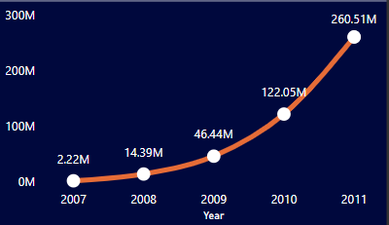
KPI-1 : Year wise loan amount Stats
We have analyzed loan amount status year-wise in leveraging two key fields: the loan issue date and the loan amount, which we've aggregated as the value in our analysis.
Providing insights into how loan amounts vary over different years and loan statuses.
This analysis helps us understand the distribution of loan amounts across various years and loan statuses, enabling us to identify trends, patterns, and potential areas for improvement or further investigation in our lending practices.

Slide 8
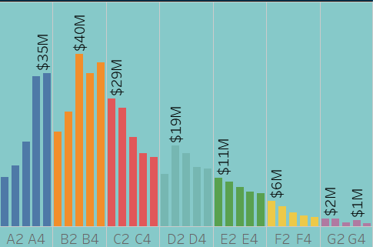
KPI-2 : Grade and sub grade wise revol bal
In this Grade and subgrade wise revolve balance we can notice Grade B have more revolve -balance then any other grades & Grade G have very low revolve balance.
The average revolving balance is higher in the ‘grade B’ and the maximum reaches in the ‘sub-grade B1’ that is 40M, Same like the average lower revolving balance is in ‘grade G’. and minimum reaches in the ‘sub-grade G5’.

Slide 9
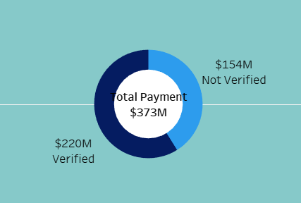
KPI-3 :Total Payment for Verified Status Vs Total Payment for Non Verified Status
As we Can see in the Donut Chart that Out of $373 Million only 59% are verified i.e. $220million
41% of $373 Million are not verified i.e. $ 154 Million. Which might be a threat to company, Should inform the verification team to take required action regarding that.

Slide 10
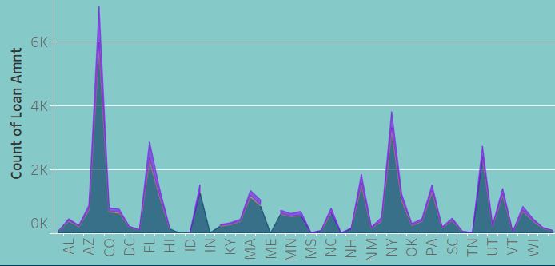
KPI-4 : State wise and Month wise Loan status
In the data set we have different states and the months along with the 3 types of loan status.
In the state wise loan status we can observe that CA,NY,TX,FL & NJ are the top states to fully paid amount.
In the month wise loan status we can observe that Dec, Nov and oct are fully paid amount.

Slide 11
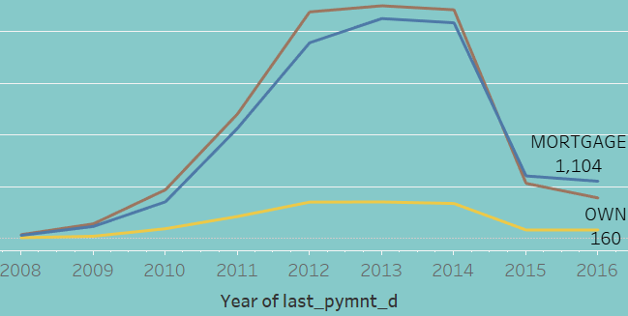
KPI-5 :Home ownership vs Last payment date stats
In this chart it is representing ratio of No. of customers who own the house on the basis of their issue date of loan.
Given chart classifies customers on basis mentioned into categories as shown in chart.

Slide 12
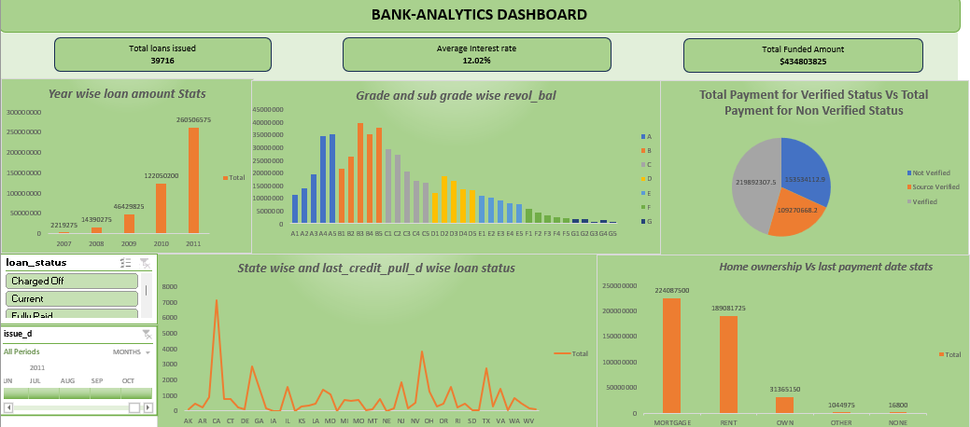
EXCEL DASHBOARD

Slide 13
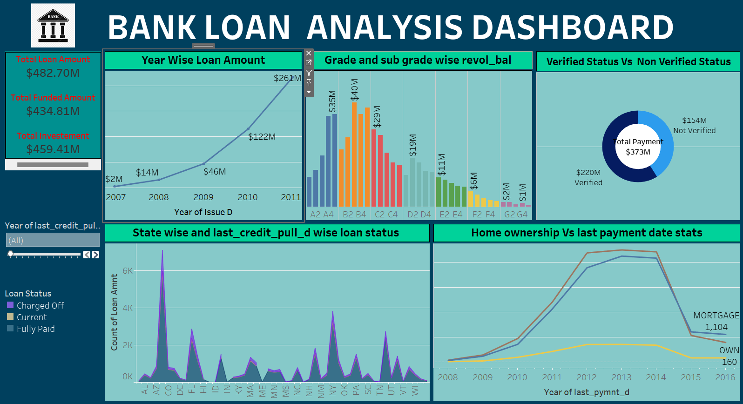
TABLEAU DASHBOARD

Slide 14
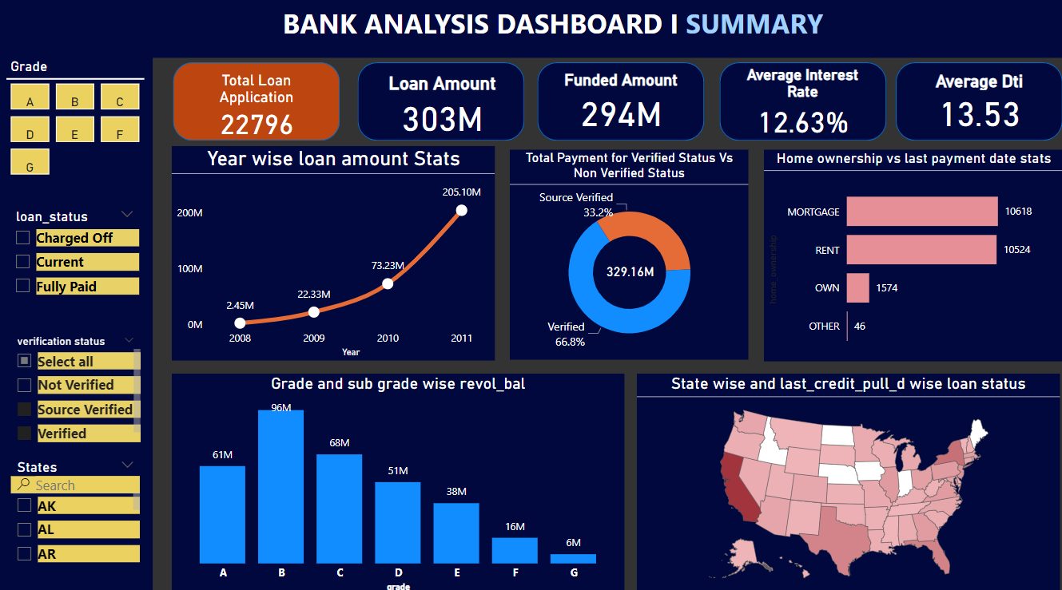
POWER BI DASHBOARD

Slide 15
CONCLUSION
Banking holds a crucial role in our day-to-day life. From the analysis of above dashboards and reports we can draw hidden insights. With the use of gained insights from the finance datasets and KPI'S. Accurate Business decisions are made and can track the business state. It enables a holistic view of the business, supporting long-term growth and competitiveness in the banking industry.

Slide 16
RECOMMENDATION
Provide personalized support to borrowers in current status for timely payments.
Support resources for managing financial responsibilities of homeowners with outright ownership.
Strengthen lending standards and risk assessment process.
Diversify loan portfolio across sectors/types for risk mitigation.

Slide 17
THANK YOU

